Slide 1
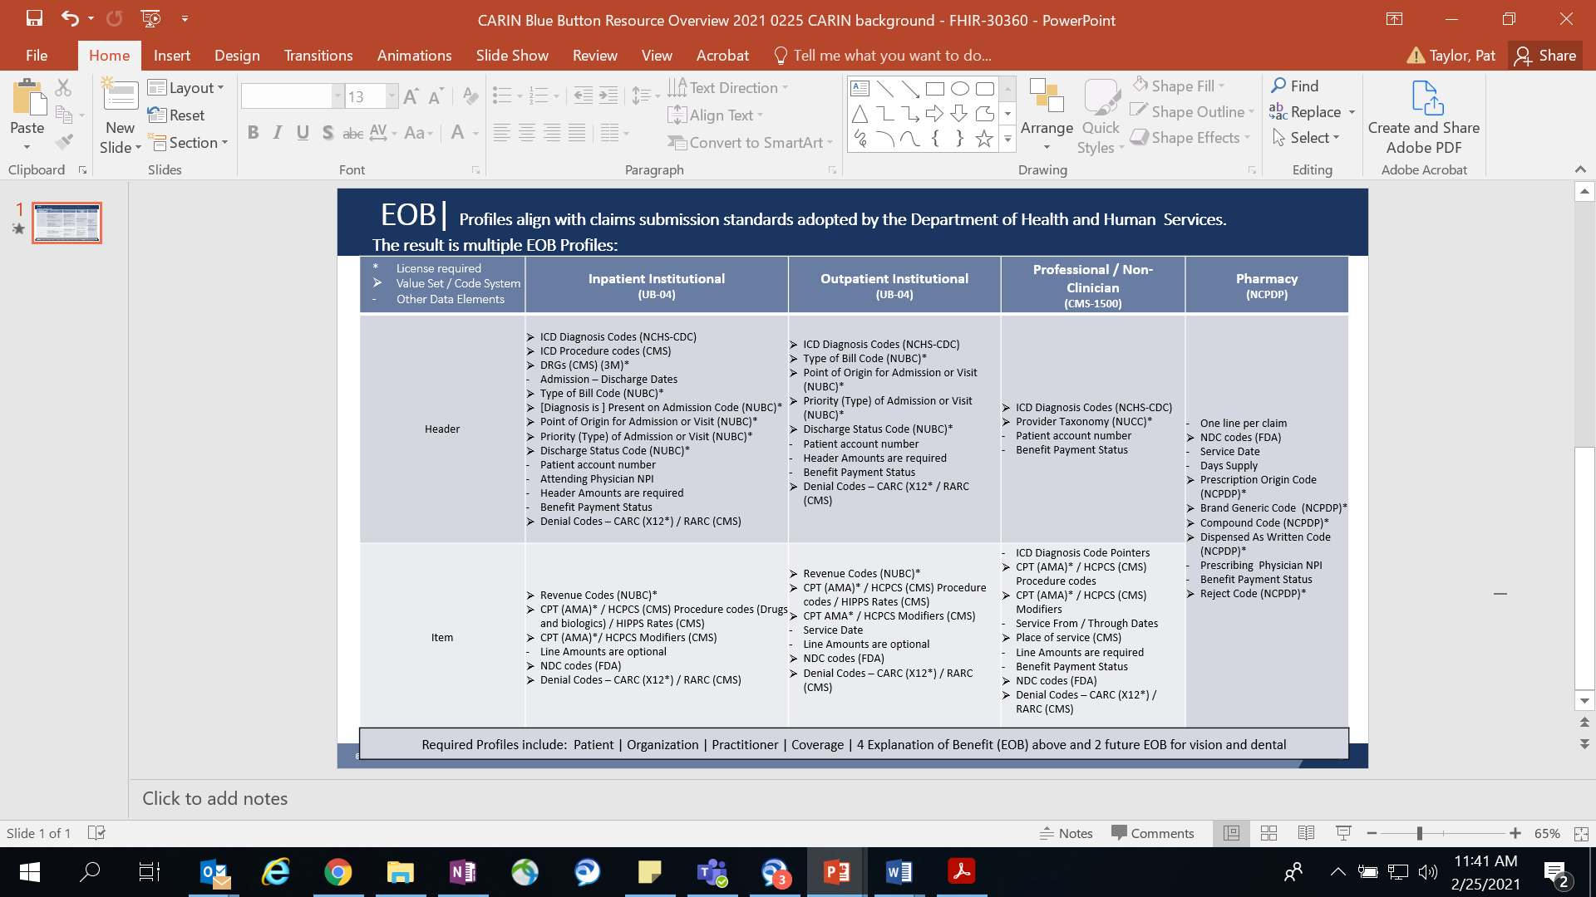
EOB Profiles
Align with Dept of Health & Human Services Claim Submission Standards

